Slide 1
In the name of Allah, Most Gracious, Most Merciful
Paper Title
Computer Vision Based Industrial and Forest Fire Detection Using Support Vector Machine (SVM)
Authors
Md. Abdur Rahman, Sayed Tanimun Hasan, Mohammed Abdul Kader
Presented By
Sayed Tanimun Hasan
Department of Electrical & Electronic Engineering
International Islamic University Chittagong (IIUC)

Slide 2
Presentation Structure
Introduction
Problem Statement
Literature Review
Objectives
Methodology
Design
Outcome and Impacts
Conclusion
Future Work
ICISET-2022 Paper ID: 165 Slide No: 2

Slide 3
Introduction
Wildfires are one of the biggest catastrophes faced by our society today causing irrevocable damages.
These forest fires can be man-made or caused by mother nature by different weather conditions, torrential winds.
These fires cause damages not only to the environment they also destroy vast homes and property.
In industries, faced by many unwanted fire incident & losing valuable life with asset
Hence we developed a system “Computer Vision Based Industrial & Forest Fire Detection Using Support Vector Machine (SVM)” to fight this disaster and help our planet.
ICISET-2022 Paper ID: 165 Slide No: 3

Slide 4
Problem Statement
Forest fires are one of the most worrisome natural disasters, destroying thousands of acres of forests and nearby urban zones, affecting plant and human life.
The forest fires are a fact of nature, and we have been serving as means of self-regulation of forests. However, these phenomena have become more frequent during the last few decades.
Besides, in industries we are facing unwanted fire incident. Fire extinguishers have existed for years but are still very difficult to maneuver. They are also very confusing when trying to use one in panic situation.
ICISET-2022 Paper ID: 165 Slide No: 4

Slide 5
Literature Review
Fast and efficient method for fire detection using image processing. [T. Celik]
Proposed fire color modeling and motion detection.
The proposed fire color model achieves a detection rate of 87.4% on the ten tested video sequences with diverse imaging conditions
2) Computer vision based fire detection in color images. [T. Celik and K.-K. Ma]
The proposed algorithm exploits the YCbCr color space to separate the luminance from the chrominance.
The proposed rule-based color model 31.5% false-alarm rate.
ICISET-2022 Paper ID: 165 Slide No: 5

Slide 6
Literature Review (Cont.)
3) An intelligent fire detection cameras based on computer vision methods. [H. Wu, D. Wu, and J. Zhao]
A motion detection method based on background subtraction is used for reducing computations.
A motion detection method based on background subtraction is used for reducing computations.
An object detection model and an image classification model are constructed and applied for fire detection.
The proposed framework achieves 87.4% fire detection and the false alarm rate achieves 16.3% based on the fire image dataset.
ICISET-2022 Paper ID: 165 Slide No: 6

Slide 7
Objectives
The main objective of the project is to develop a fire detection technique in real time. The main points of the project objectives are given below:
To detect fire while they are still small and have not grown too large.
To develop a low cost fire detection system in real time.
A system that detects a fire earlier than conventional fire detectors and more accurate.
ICISET-2022 Paper ID: 165 Slide No: 7

Slide 8
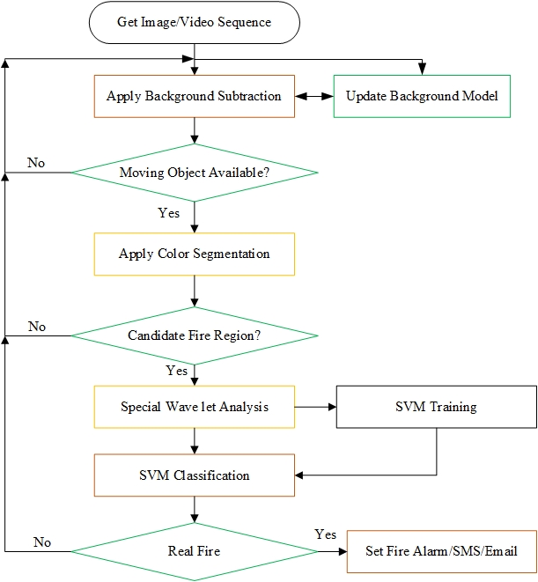
Methodology
Flowchart
ICISET-2022 Paper ID: 165 Slide No: 8

Slide 9
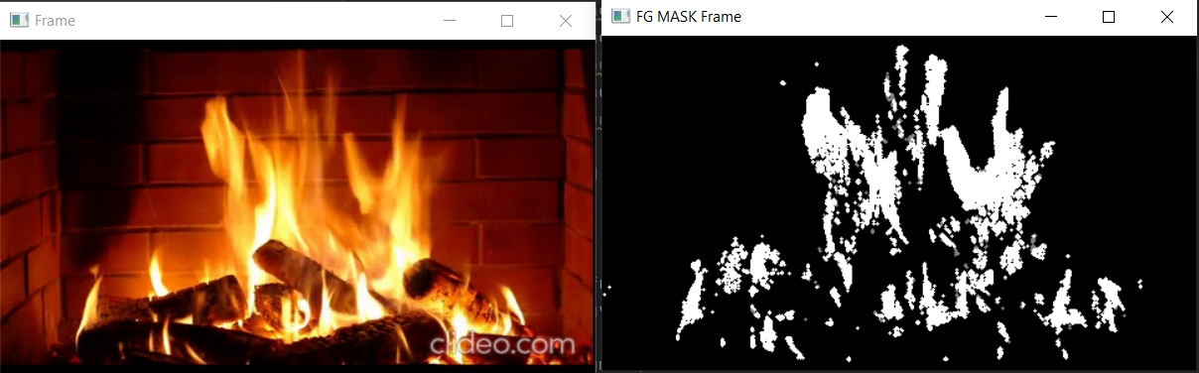
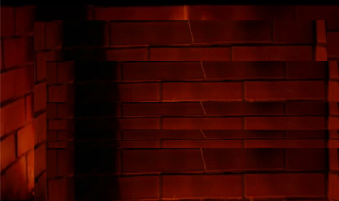
Methodology
Background Subtraction
Current Frame
THRESHOLD
T
Foreground mask
>
Background model
ICISET-2022 Paper ID: 165 Slide No: 9

Slide 10
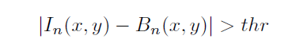
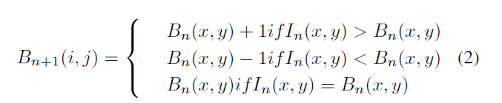
Methodology
Background Subtraction (Cont.)
ICISET-2022 Paper ID: 165 Slide No: 10

Slide 11
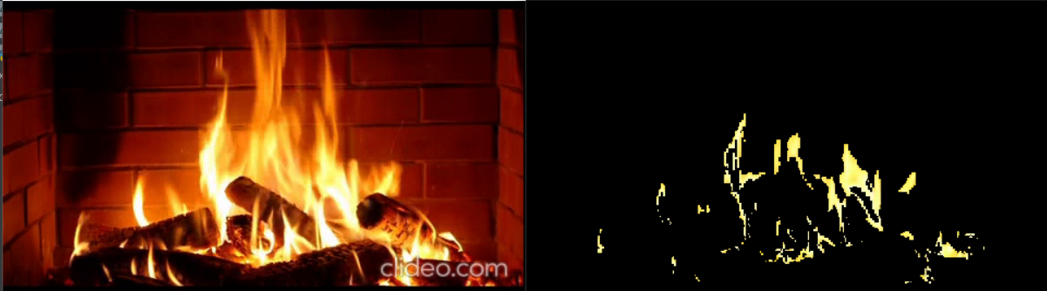


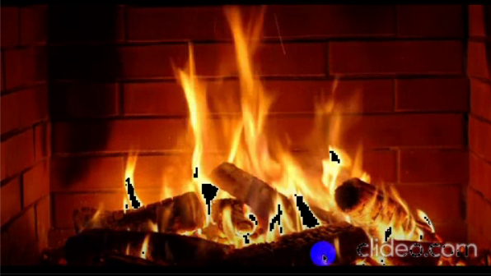
Methodology
Color Segmentation
Input footage
Red
Green
Blue
Result
ICISET-2022 Paper ID: 165 Slide No: 11

Slide 12
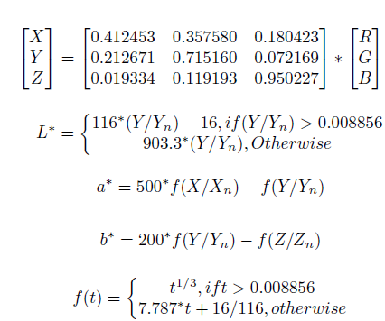
Methodology
Color Segmentation (Cont.)
ICISET-2022 Paper ID: 165 Slide No: 12

Slide 13
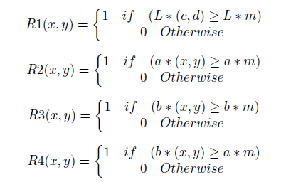
Methodology
Color Segmentation (Cont.)
ICISET-2022 Paper ID: 165 Slide No: 13

Slide 14
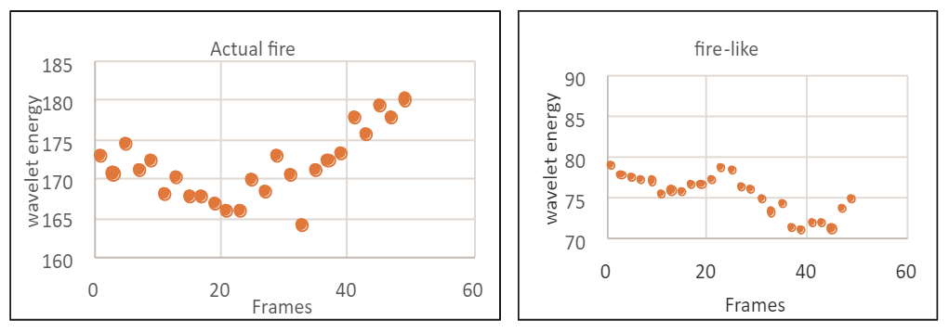
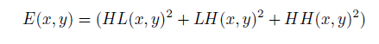
Methodology
Spatial Wavelet Analysis
ICISET-2022 Paper ID: 165 Slide No: 14

Slide 15
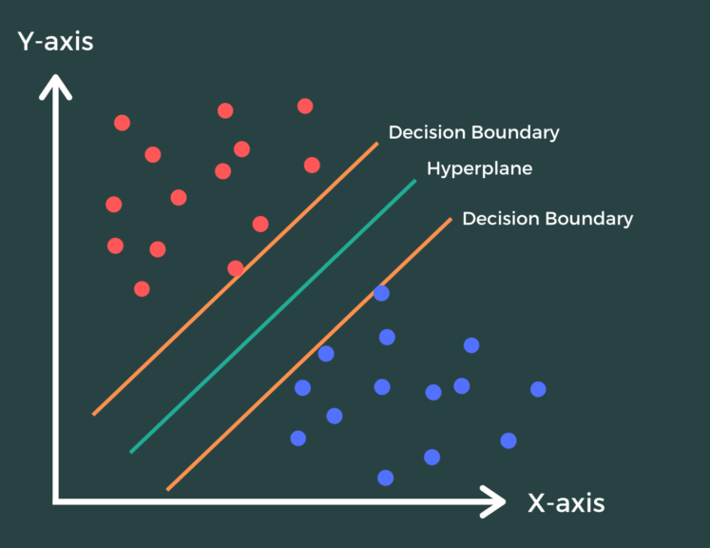
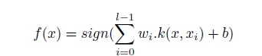
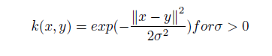
Methodology
Support Vector Machine
ICISET-2022 Paper ID: 165 Slide No: 15

Slide 16
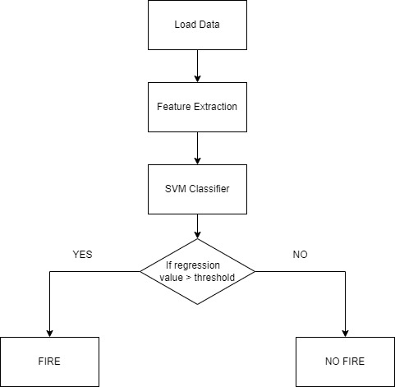
Methodology
Support Vector Machine Classifier
ICISET-2022 Paper ID: 165 Slide No: 16

Slide 17
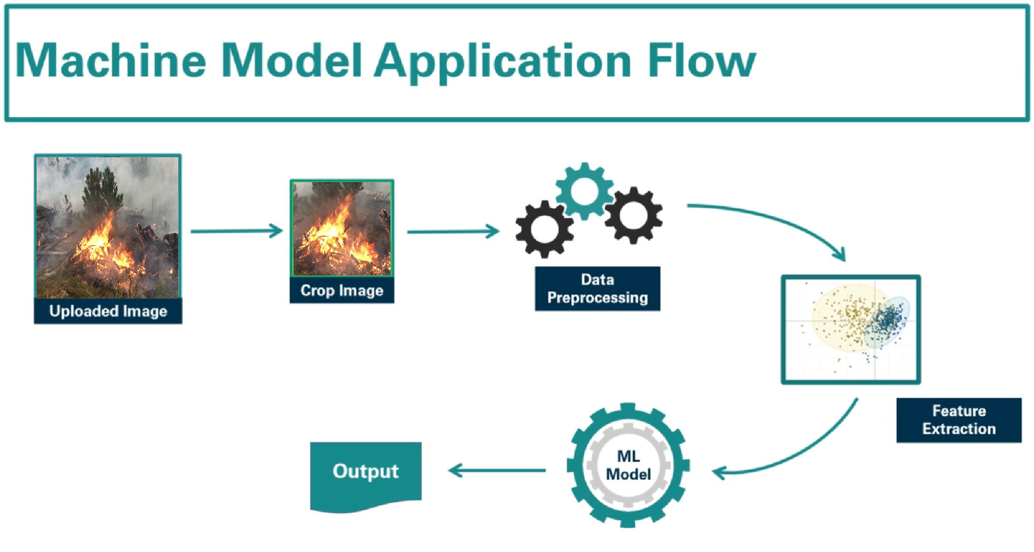

SVM
Background Subtraction (BS) + Color Segmentation (CG) + Spatial Wavelet Analysis (SWA)
ICISET-2022 Paper ID: 165 Slide No: 17

Slide 18
Design
Color Segmentation
Support Vector Machine (SVM)
Pipeline Model
BS
CS
SWA
SVM
Background Subtraction
Spatial Wavelet Analysis
ICISET-2022 Paper ID: 165 Slide No: 18

Slide 19
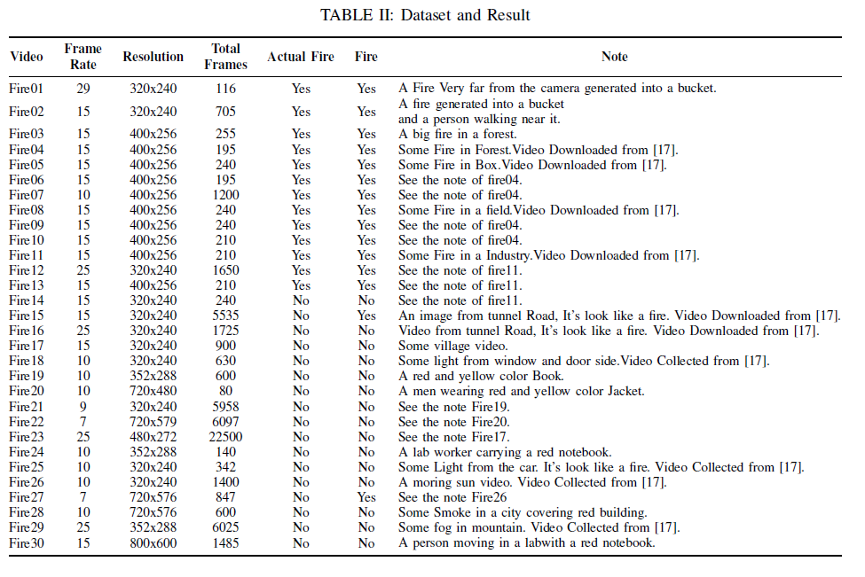
Result & Analysis
Dataset & Result
ICISET-2022 Paper ID: 165 Slide No: 19

Slide 20
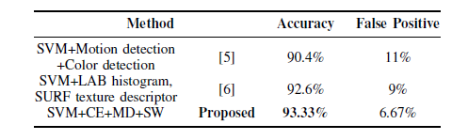
Result & Analysis (Cont.)
COMPARISON OF THE PROPOSED AND APPROACH
WITH OTHER SVM SYSTEM
93.33%
ICISET-2022 Paper ID: 165 Slide No: 20

Slide 21
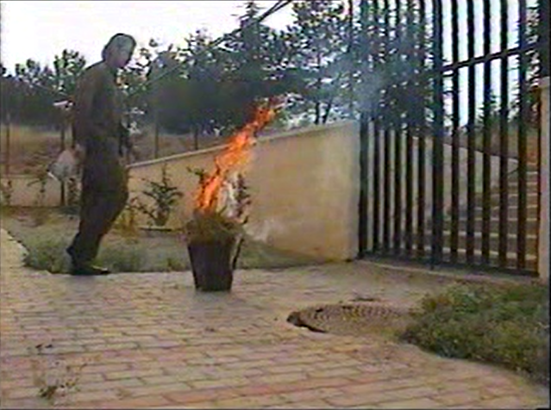
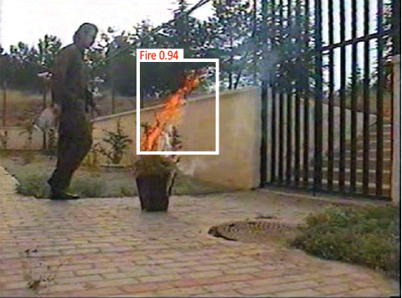
Outcome and Impacts
Input Footage
Output
Fire Detected
ICISET-2022 Paper ID: 165 Slide No: 21

Slide 22
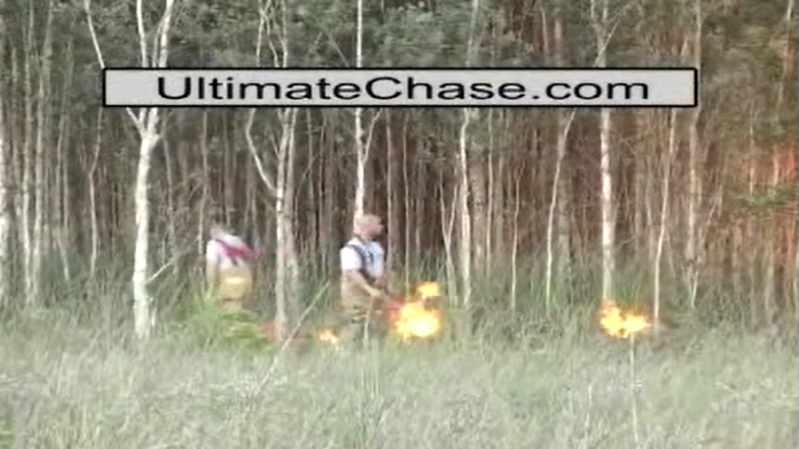
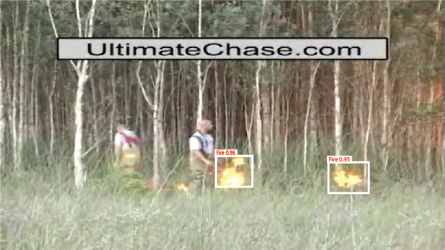
Outcome and Impacts (Cont.)
Input Footage
Output
Fire Detected
ICISET-2022 Paper ID: 165 Slide No: 22

Slide 23
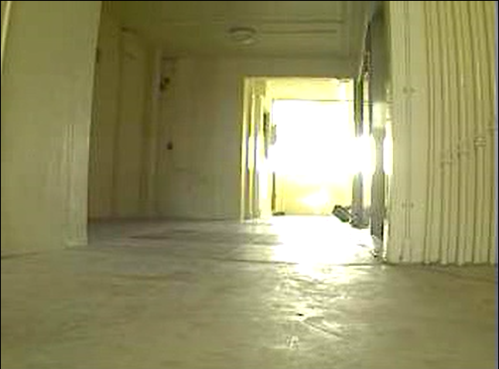
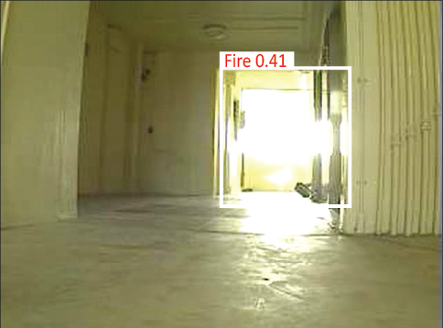
Outcome and Impacts (Cont.)
Input Footage
Output
False fire Detected
ICISET-2022 Paper ID: 165 Slide No: 23

Slide 24
Conclusion
The proposed approach is on average 93.33 percent on a random sample, while the false positive rate is only 6.67 percent in two fire-color motion videos.
The performance of our approach is capable of meeting the requirements for accuracy and control in real-time fire detection.
Its industrial and forest application will enable the detection of fires at an early stage, the facilitation of emergency management, and a significant contribution to the avoidance of losses.
ICISET-2022 Paper ID: 165 Slide No: 24

Slide 25
Future Work
Integrate live satellite data and process real time processing of the fires .
Enhance the time complexity of the detection of fires to improve the speed.
Web based application for fire detection integration with developed system
ICISET-2022 Paper ID: 165 Slide No: 25

Slide 26
References
[1] A. Pathak, A. Tasin, A. Esho, A. Munna, and T. Chowdhury, “A smart semi-autonomous fire extinguish quadcopter: future of bangladesh” Int.J. Adv. Res, vol. 8, pp. 01–15, 2020.
[2] T. Celik, “Fast and efficient method for fire detection using image processing,” ETRI journal, vol. 32, no. 6, pp. 881–890, 2010.
[3] T. Celik and K.-K. Ma, “Computer vision based fire detection in color images,” in2008 IEEE Conference on Soft Computing in Industrial Applications. IEEE, 2008, pp. 258–263.
[4] P. Foggia, A. Saggese, and M. Vento, “Real-time fire detection for video-surveillance applications using a combination of experts based on color, shape, and motion,” IEEE TRANSACTIONS on circuits and systems for video technology, vol. 25, no. 9, pp. 1545–1556, 2015.
[5] W. Jiayun, “Real-time visual detection of early manmade fire,” in 2015 IEEE International Conference on Information and Automation. IEEE,2015, pp. 993–997.
[6] B. Jiang, Y. Lu, X. Li, and L. Lin, “Towards a solid solution of real-time fire and flame detection,” Multimedia Tools and Applications, vol. 74,no. 3, pp. 689–705, 2015.
ICISET-2022 Paper ID: 165 Slide No: 26

Slide 27
References
[7] H. Wu, D. Wu, and J. Zhao, “An intelligent fire detection cameras based on computer vision methods,” Process Safetyand Environmental Protection, vol. 127, pp. 245–256, 2019.
[8] S. S. Moumgiakmas, G. G. Samatas, and G. A. Papakostas, “Computer vision for fire detection on uavs—from software to hardware,” Future Internet, vol. 13, no. 8, p. 200, 2021.
[9] K. Muhammad, J. Ahmad, and S. W. Baik, “Early fire detection using convolutional neural networks during surveillance for effective disaster management,” Neuro computing, vol. 288, pp. 30–42, 2018.
[10] C. Filizzola, R. Corrado, F. Marchese, G. Mazzeo, R. Paciello, N. Per-gola, and V. Tramutoli, “Rst-fires, an exportable algorithm for early-fire detection and monitoring: Description, implementation, and field validation in the case of the msg-seviri sensor,” Remote Sensing of Environment, vol. 186, pp. 196–216, 2016.
[11] C. Singh, E. Walia, and K. P. Kaur, “Enhancing color image retrieval performance with feature fusion and non-linear support vector machine classifier,” Optik, vol. 158, pp. 127–141, 2018.
[12] Y. Sun, C. Xu, G. Li, W. Xu, J. Kong, D. Jiang, B. Tao, and D. Chen, “Intelligent human computer interaction based on non redundant emg signal,” Alexandria Engineering Journal, vol. 59, no. 3, pp. 1149–1157,2020.
ICISET-2022 Paper ID: 165 Slide No: 27

Slide 28
References
[13] M. Kang, T. X. Tung, and J.-M. Kim, “Efficient video-equipped fire de-tection approach for automatic fire alarm systems,” Optical Engineering, vol. 52, no. 1, p. 017002, 2013.
[14] M. A. I. Mahmoud and H. Ren, “Forest fire detection and identification using image processing and svm,”Journal of Information Processing Systems, vol. 15, no. 1, pp. 159–168, 2019.
[15] B. U. Töreyin, Y. Dedeo ̆glu, U. Güdükbay, and A. E. Cetin, “Computer vision based method for real-time fire and flame detection,” Pattern recognition letters, vol. 27, no. 1, pp. 49–58, 2006.
[16] S. Theodoridis, A. Pikrakis, K. Koutroumbas, and D. Cavouras, Intro-duction to pattern recognition: a matlab approach. Academic Press,2010.
[17] E. Cetin, “Computer vision based fire detection dataset.[online].”Avail-able: http://signal.ee.bilkent.edu.tr/VisiFire/, 2014
ICISET-2022 Paper ID: 165 Slide No: 28

Slide 29
Acknowledgement
This work has been done entirely on a volunteer basis, and had not received any grants or funds from any organization or individual. We would like to express our respect and appreciation to our supervisor Engr. Mohammed Abdul Kader for his guidance and reviewers for their insightful comments and feedback.
ICISET-2022 Paper ID: 165 Slide No: 29

